Slide 1
GENERATIONS OF COMPUTER
Designed By
Future IT
Category: Technology

Slide 2
HISTORY
A GENERATION REFERS TO THE STATE OF IMPROVEMENT IN THE DEVELOPMENT OF A PRODUCT.
EACH GENERATION OF COMPUTER IS CHARACTERIZED BY A MAJOR TECHNOLOGICAL DEVELOPMENT THAT CHANGED THE WAY COMPUTERS OPERATE
RESULTING IN INCREASINGLY SMALLER,CHEAPER AND MORE POWERFUL,MORE EFFICIENT AND RELIABLE DEVICES..

Slide 3
KEYPOINTS:
FIRST GENERATION FROM(1940) TO (1956):VACUUM TUBE TECHNOLOGY.
2ND GENERATIONS FROM(1956) TO (1963):TRANSISTOR TECHNOLOGY.
3RD GENERATIONS FROM(1964) TO (1971):INTEGRATED CIRCUIT TECHNOLOGY.
4TH GENERATION FROM(1972) TO (1984): MICROPROCESSORS.
5TH GENERATION FROM(1984) TO (1990): ARTIFICIAL INTELLIGENCE.
6TH GENERATION FROM(1990)-TILL DATE NANOTECHNOLOGY.

Slide 4
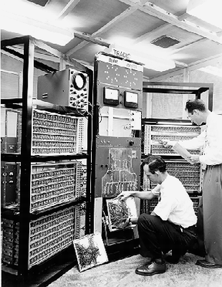
FIRST GENERATION
CONCEPT OF FIRST GENERATION.
FEATURES OF FIRST GENERATION.
TWO TYPES OF MACHINES OF FIRST GENERATION,UNIVAC AND ENIAC.

Slide 5
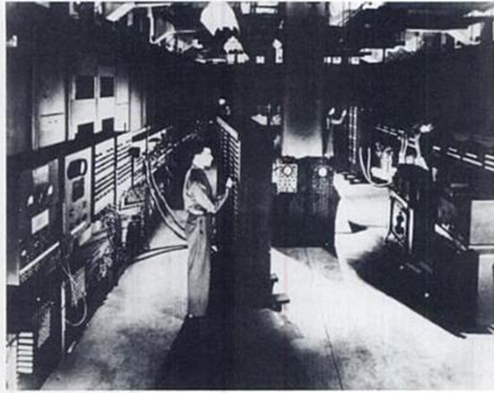
CONCEPT
THE FIRST GENERATION COMPUTERS WERE RUN BY SEVERAL TYPES OF MEMORIES AND STEP BY STEP ADVANCEMENT IN THE TECHNOLOGY FOR THE DEVELOPMENT OF MEMORIES.
FIRST GENERATION COMPUTERS CAN BE CATEGORIZED BY THEIR USE OF VACUUM TUBES TO STORE INDIVIDUAL BITS OF DATA.

Slide 6
FEATURES:
USE OF VACUUM TUBES FOR CIRCUITRY.
USE MAGNETIC DRUMS FOR MEMORY.
CHARACTERISTICS.

Slide 7
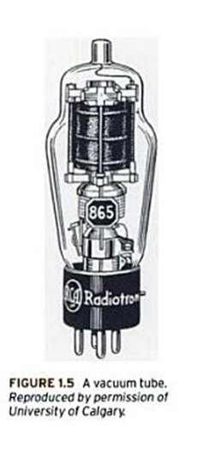
VACUUM TUBES
Vacuum tubes were the fragile glass devices that can control and amplify electronic signals.
Purpose of vacuum tubes was to act like as amplifier and switch.
Without any moving parts vacuum tubes could take very weak signals and make them stronger(amplify it).
They are suppose to stop and start the flow of current instantly (switch) They were used to give instructions in binary code.

Slide 8
MEMORY
MAGNETIC DRUMS ALSO REFERRED TO AS A DRUM,IT IS A METAL CYLINDER COATED WITH MAGNETIC-OXIDE MATERIAL.
THEIR WERE TRACKS ON THE MAGNETIC DRUM FORMING ADJACENT CIRCULAR BANDS THAT WIND AROUND THE DRUM.
A SINGLE DRUM CAN HAVE UP TO 200 TRACKS,IT ROTATES AT A SPEED OF UP TO 3,000 RPM.

Slide 9
DRAWBACKS
BIG & CLUMSY.
HIGH ELECTRICITY CONSUMPTION.
PROGRAMMING IN MECHANICAL
LANGUAGE.
LARGER AC WERE NEEDED.
LOT OF ELECTRICITY FAILURE OCCURED.

Slide 10
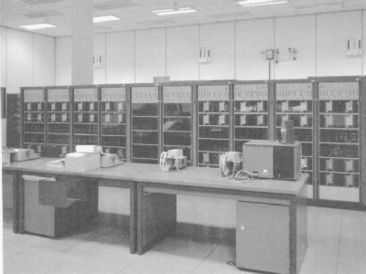

Slide 11
SECOND GENERATIONS
FEATURES:
TRANSISTORS.
CORE MEMORY.
PROGRAMMING WAS IN MACHINE & ASSEMBLY LANGUAGE.
MAGNETIC TAPES & DISCS WERE USE.
OTHER CHARACTERISTICS.

Slide 12
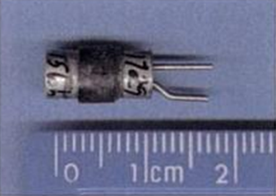
TARNSISTORS
TRANSISTORS REPLACED VACUUM TUBES.
TRANSISTOR IS A DEVICE COMPOSED OF SEMICONDUTOR MATERIAL THAT AMPLIFIES A SIGNAL OR OPENS OR CLOSE A CIRCUIT.
INVENTED IN 1947 AT BELL LABS.
TRANSISTORS BECOME THE HEYING RESIDIENT OF ALL DIGITAL COMPUTERS.

Slide 13
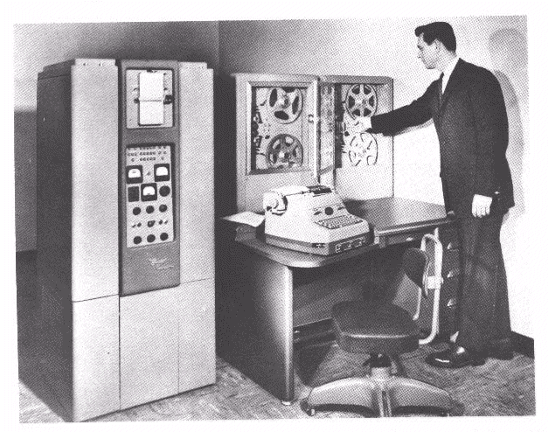

Slide 14
CORE MEMORY
THE SWITCHING TIME CAME DOWN TO 0.3 MICROSECONDS.
MEMORY SHIFTED FROM MAGNETIC DRUM TO MAGNETICCORE TECHNOLOGY.

Slide 15
PROGRAMMING
SECOND-GENERATION COMPUTERS MOVED FROM BINARYMACHINE LANGUAGE TO SYMBOLIC OR ASSEMBLY LANGUAGES.
HIGH-LEVEL LANGUAGES LIKE COBOL AND FORTRON WERE DEVELOPED AT THIS TIME.

Slide 16
MAGNETIC TAPES AND DISCS
MAGNETIC DISK,A NEW EXTERNAL AUXILIARY STORAGE DEVICE WAS DEVELOPED.
MAGNETIC DISC IS FASTER THAN MAGNETIC TAPE.
BY THIS TECHNOLOGY EACH DATA ITEM CAN BE ACCESSED DIRECTLY BY REFERING TO ITS LOCATION ON THE DISC.

Slide 17
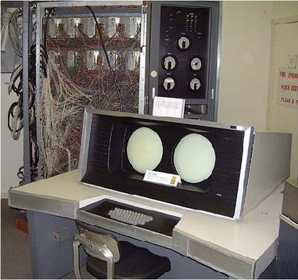
OTHER CHARACTERISTICS
FASTER THAN FIRST GENERATION COMPUETRS.
FIRST OPERATING SYSTEMS WAS DEVELOPED.
COMPUTER’S SIZE BECAME SMALLER.
COMPUTERS CONSUMED LESS HEAT.
LESS CONSUMPTION OF ELECTRICITY.

Slide 18
THIRD GENERATION
INTEGRATED CIRCUITS DEVELOPED
CHARACTERISTICS
SSI & MSI TECHNOLOGY WAS USED
HIGH LEVEL LANGUAGES WERE USED.
OTHER FEATURES.

Slide 19
CIRCUIT TECHNOLOGY
THE DEVEOPLMENT OF INTEGRATED CIRCUIT WAS THE KEYPOINT OF THE THIRD GENERATION OF COMPUTERS.
DOZENS OF TRANSISTORS WERE PLACES ON A SINGLE CHIP MADE OF SILICON,CALLED SEMICONDUTOR.
WHICH HAD A LAGRE IMPACT ON THE INCREASE IN SPEED AND EFFICIENCY OF COMPUTERS.

Slide 20
Synthetic detail of an integrated circuit through four layers of planarized copper interconnect.
JACK KIBY’S ORIGINAL IC

Slide 21
CHARACRTERISTICS
POWER CONSUMPTION WAS LOW AS COMPARE TO SECOND GENERATION COMPUTERS.
THEY WERE SMALL IN SIZE AND FASTER.SOME OF THEM HAVE ONLY SIZE OF A SMALL REFRIGERATOR.
INTERACTION MEDIUM WERE KEYBOARDS AND MONITORS,INSTEAD OF PUNCH CARDS.

Slide 22
SSI & MSI TECHNOLOGYGY
THE FIRST INTEGRATED CIRCUITS CONTAINED ONLY A
FEW TRANSISTORS,CALLED “SMALL-SCALE INTEGRATION”(SSI).
THE NEXT STEP IN THE DEVELOPMENT OF IC RESULTS IN INTRODUCING “MEDIUM-SCALE INTEGRATION” (MSI).
MSI CONTAINS HUNDREDS OF TRANSISTORS ON EACH CHIP,COSTS LITTLE AND SMALL IN SIZE.

Slide 23
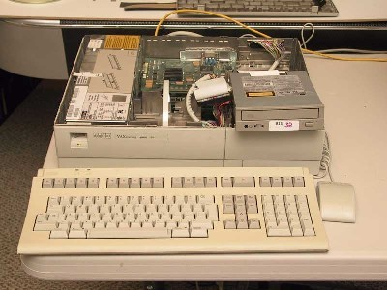
OTHER FEATURES
USE OF SEMICONDUCTOR MEMORIES.
MICROPROGRAMMING.
VARIOUS PATTERNS OF PARALLEL PROCESSING.
INTRODUCTION OF OS AND TIME-SHARING.
USE OF HIGH LEVEL LANGUAGES.

Slide 24
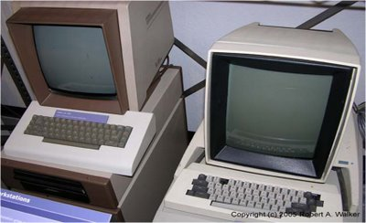

Slide 25
FOURTH GENERATION
MICROPROCESSORS.
DEVELOPMENT OF COMPUTER PROGRAMS.
COMMUNICATION
PROGRAMMING LANGUAGES.
OTHER FEATURES.

Slide 26
MICROPROCESSORSGY
LARGE SCALE INTEGRATION(LSI) COULD FIT HUNDREDS
OF COMPONENTS ONTO ONE CHIP.
MARCIAN HOFF INEVENTED A DEVICE WHICH COULD REPLACE SEVERAL OF THE COMPONENTS OF EARLIER COMPUTERS,THE MICROPROCESSOR.
CAPABLE OF PERFORMING ALL OF THE FUNCTIONS OF A COMPUTER’S CPU IN ALL FORTH GENERATION COMPUTERS.

Slide 27
4TH GENERATION IC
INTEL PENTIUM CPU

Slide 28
COMPUTER PROGRAMS
WORD PROCESSING.
SPREADSHEETS.
DATABASE MANAGEMENT.
STATISTICAL SOFTWARES.
GRAPHICS.

Slide 29
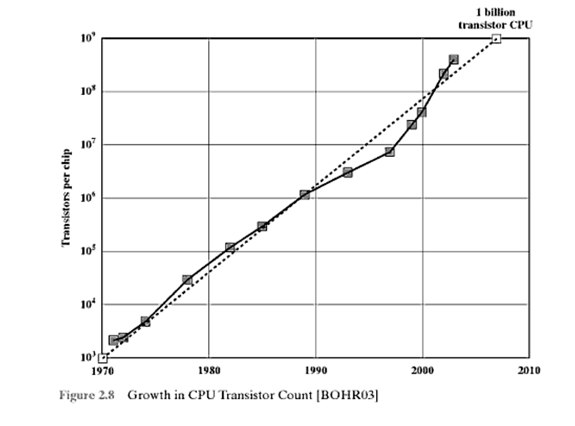

Slide 30
COMMUNICTAION
MICROCOMPUTERS HAVE THE UNIQUE FEATURE OF BEING ABLE TO BE USED BOTH AS A SINGLE USER COMPUTER.
ALSO AS A TERMINAL TO A LARGER MULTIUSER COMPUTER.
COMMUNICATION SOFTWARES WERE DEVELOPED.

Slide 31
PRORAMMING LANGUAGESGY
HIGH-LEVEL LANGUAGES LIKE FUNCTIONAL PROGRAMMMING(PF) AND PROLOG(PROGRAMMING IN LOGIC) WERE DEVELOPED.
ALTERNATIVELY LANGUAGES LIKE PASCAL,C USED IMPERATIVE STYLE i.e DESCRIBING COMPUTATION IN TERMS OF STATEMENTS.

Slide 32
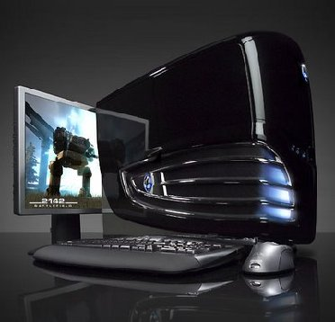

Slide 33
OTHER FEATURES:
PORTABLE COMPUTERS WAS THE GREAT DEVELOPMENT.
REQUIRES LESS SPACE,LIGHT WEIGHT.
FASTER AND MORE RELIABLE.
POWERFUL NETWORKING.
DEVELOPMENT OF GUIs, THE MOUSE AND HANDHELD DEVICES.

Slide 34
FIFTH GENERATION
INTRODUCTION:
FIFTH GENERATION COMPUTERS ARE BASED ON ARTIFICIAL INTELLIGENCE.
ARTIFICIAL INTELLIGENCE IS THE BRANCH OF COMPUTER SCIENCE WHICH MAKES COMPUTERS BEHAVE LIKE HUMANS.
THE TERM ‘ARTIFICIAL INTELLIGENCE’ WAS COINED IN 1965 BY JOHN MSCARTHY.
COMPUTING BASED ON THIS TECHNOLOGY IS STILL IN PROCESS.

Slide 35
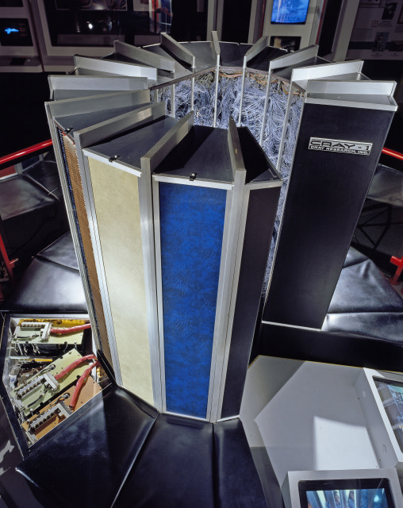

Slide 36
FEATURESGY
PARALLEL PROCESSING.
SUPERCONDUCTORS.
VOICE RECOGNITION.
INTELLIGENT ROBOTS.
ARTIFICIAL INTELLIGENCE.

Slide 37
PARALLEL PROCESSING
PARALLEL PROCESSING MEANS TO EXECUTE MORE THAN ONE PROGRAM OR MULTIPLE COMPUTATIONAL THREADS.
MASSIVELY PARALLEL PROCESSING(MPP) IS USED ALONG WITH ARTIFICIAL INTELLIGENCE TO MAKE COMPUTERS BEHAVE LIKE SUPERCOMPUTERS..

Slide 38
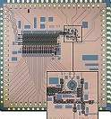
SUPERCONDUCTOR TECHNOLOGY
THE NATIONAL SCIENCE FOUNDATION ALONG WITH NASA AND DARPA AND VARIOUS UNIVERSITIES ARE CURRENTLY RESEARCHING ‘PETAFLOP’ COMPUTERS.
A PETAFLOP IS A THOUSAND-TRILLION FLOATING POINT OPERATIONS PER SECOND.
TODAY’S FASTEST COMPUTER HAVE REACHED ‘PETAFLOP’ SPEEDS-QUADRILLIONS OF OPERATIONS PER SECOND.

Slide 39
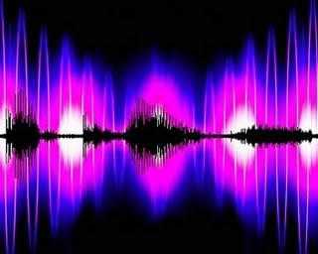
SPEECH RECOGNITIONY
VOICE RECOGNITION SOFTWARES DEALS WITH RECOGNIZING HUMAN VOICE SPOKEN IN HUMAN LANGUAGES.
THESE SOFTWARES ARE EXPENSIVE AND HAVE SOME FLAWS,DUE TO WHICH THEY ARE USED IN FEW SITUATIONS.

Slide 40
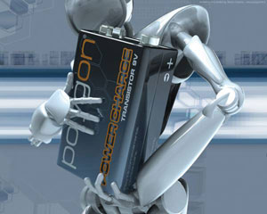
INTELLIGENT ROBOTSY
ROBOTS ARE THE PROGRAMMING COMPUTERS TO SEE AND HEAR AND REACT TO OTHER SENSORY STIMULI.
BUT THEY ARE CAPABLE OF VERY LIMITED TASKS.
A LOT OF DEVELOPMENT IS NEEDED IN THIS TECHNOLOGY TO OVERCOME CLUMSY MOVEMENTS AND OBJECT HANDLING OF ROBOTS.

Slide 41
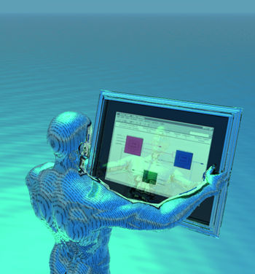
ARTIFICIAL INTELLIGENCE
ARTIFICIAL INTELLIGENCE IS CONCERNED IN MAKIING COMPUTERS BEHAVE LIKE HUMANS.
ARTIFICILA INTELLIGENCE INCLUDE:
GAMES PLAYING.
EXPERT SYSTEMS.
NATURAL LANGUAGES.
THEORM PROVING.
ROBOTICS AND NAVIGATION.

Slide 42
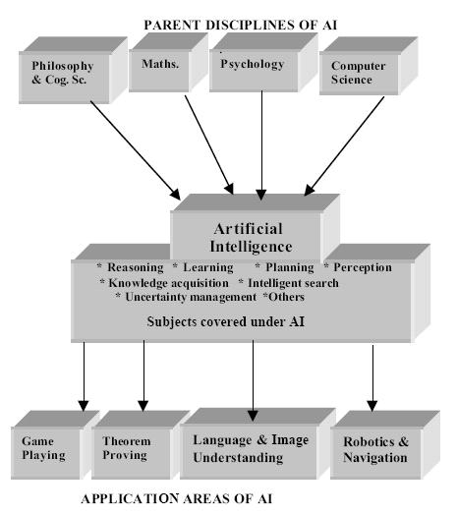

Slide 43
SIXTH GENERATION
TRANSITIONS BETWEEN GENERATION IS HARD TO DEFINE,ESPACIALLY WHEN THEY ARE IN PROCESS.
SIXTH GENERATION COMPUTERS ARE BASED ON ARTIFICIAL INTELLIGENCE BY ADOPTING PARALLEL PROCESSING.
THERE WILL BE MORE ADVANCE TECHNOLOGY SUCH AS NANOTACHNOLOGY AND QUANTUM PROCESSING.

Slide 44
"pen-based" approach to next generation computer interfaces recently demo'd by NEC corp.

Slide 45
FEATURESGY
FIRST PHASE OF SIXTH GENERATION COMPUTERS HAVE THE KEY FEATURES LIKE CLUSTER-TO-CLUSTER PARALLELISM,TURELY MASSIVE PARALLELISM.
VERY LARGE MEMORIES WITH HIERARICHAL ORGANIZATION, VERY HIGH SPEED WITH PEAK PERFORMANCE,NETWORKING AND DISTRIBUTED COMPUTING ON PERSONAL COMPUTERS.
MAKING SIGNAL RECOGNITION ENGINES MORE STRONG,EXPERT-SYSTEMS AND ARTIFICIAL INTELLIGENCE WITH SYSTEM AND APPLICATION SOFTWARES.

Slide 46
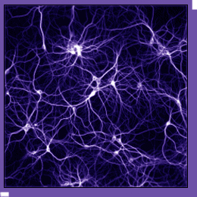
NEURAL COMPUTING
NEURAL COMPUTING AIMS TO DEVELOP IDEAS FROM NUEROSCIENCE INTO A FORM THAT IS PROMISING FOR THE DEVELOPMENT OF THE PRESENT GENERATION.
IT IS BASED ON COOPERATIVE COMPUTATION,THAT MEANS THE COMPUTER WILL PE PRACTICALLY A PROBLEM-SOLVING
NETWORK, RATHER THAN A SINGLE SERIAL
MACHINE.
ISPIRED FROM THE HUMAN BRAIN WHICH
IS DIVIDED INTO SEVERAL PARTS,COMPUTER
WILL THUS BE A NETWORK OF SPECIAL
PURPOSE MACHINES.

Slide 47
NANOTECHNOLOGY
NANOTECHNOLOGY BASED COMPUTER SYSTEMS WILL USE MEMORY MADE OF GRAPHENE.
GRAPHENE IS A FLAT ONE-ATOM THICK SHEET OF CARBON,IT NEVER STOPS CONDUCTING.
GRAPHENE MEMORY COULD BE USED AS A MEMORY TO EXCEED THE PERFORMANCE,AND AMOUNT OF STORAGE BY A FACTOR OF 5 USING NANOCABLES.

Slide 48
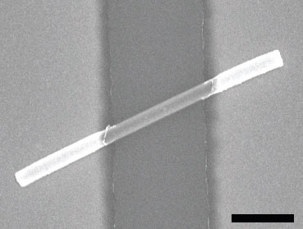
image of a G–SiO2 nanocable two-terminal device. Scale bar = 250 nm

Slide 49
HOWEVER THE GENERATIONS ARE VERY HARD TO CONCLUDE,AS CONTINUOS WORK AND SEARCH ALONGWITH IMPLEMENTATION IS IN PROCESS.
MOST OF THE DOCUMENTATION AND SEACRH IS DONE FOR THE IMPLEMENTATION OF NANOTECHNOLOGY.
WHICH WILL COMPLETELY CHANGE THE PRESENT CONCEPT ABOUT COMPUTERS AND MAKE THEM THINK AND BEHAVE MORE PERFECT THAN A HUMAN BEING.

